Slide 1
Data Visualization & Interpretation
Febin.A.Vahab

Slide 2
VISUAL ANALYTICS

Slide 3
PLAN
UNDERSTANDING DESCRIPTIVE STATISTICS
REFERENCE OBJECTS
TREND LINES and FORECASTING
BOX PLOTS
CLUSTERING
SETS

Slide 4
SUMMARY CARD

Slide 5
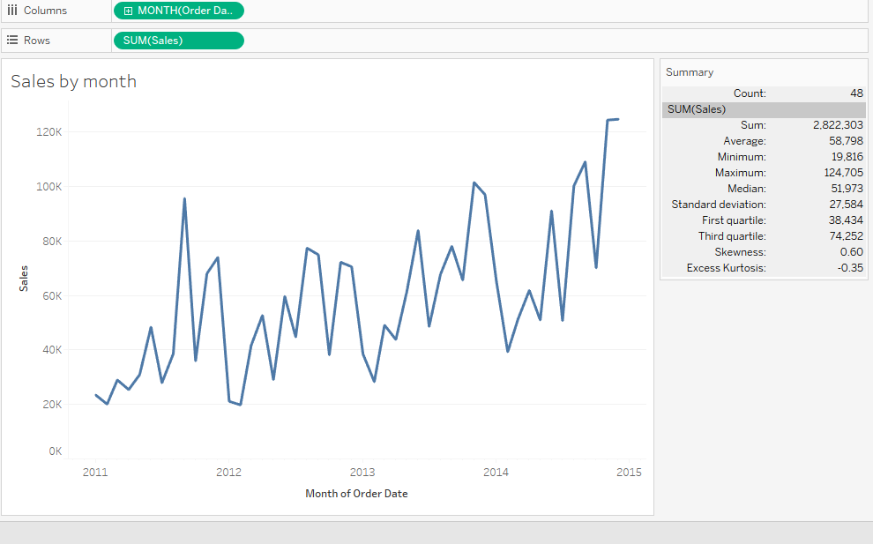
WORKSHEET SUMMARYCARD

Slide 6
AVAILABLE STATISTICS
DEFAULT
COUNT
SUM
AVERAGE
MINIMUM
MAXIMUM
MEDIAN
ADDITIONAL
SD
FIRST QUARTILE
THIRD QUARTILE
SKEWNESS
EXCESS KURTOSIS

Slide 7
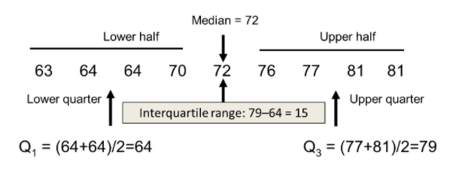
QUARTILES

Slide 8
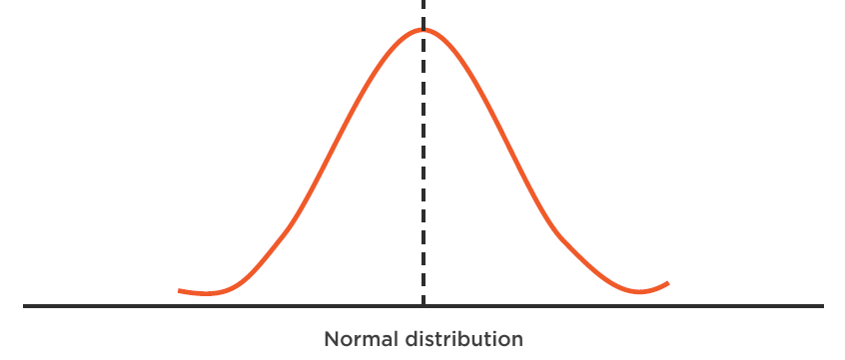
Skewness

Slide 9
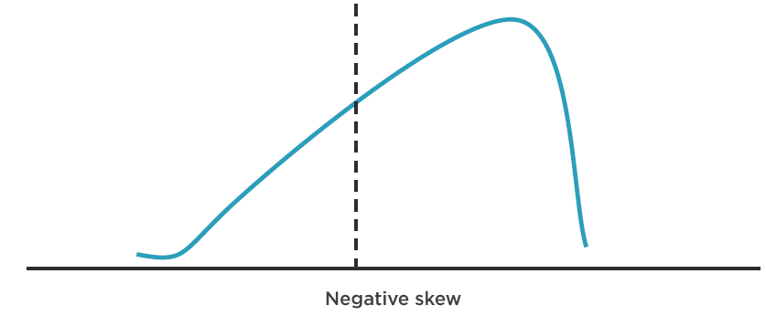
Skewness

Slide 10
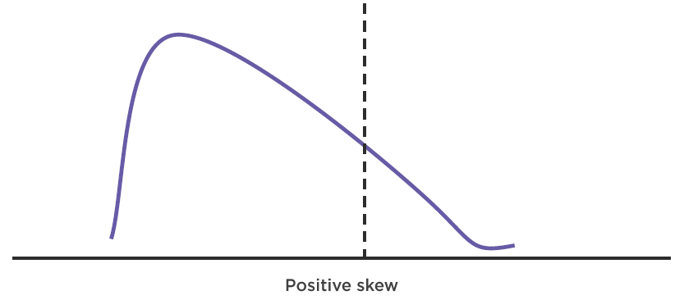
Skewness

Slide 11
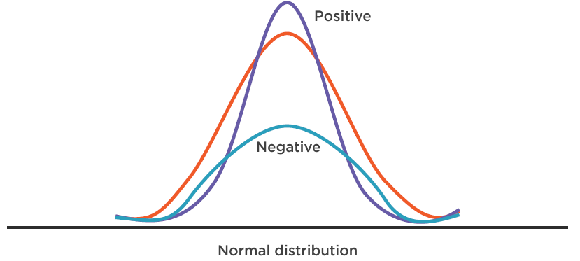
Kurtosis

Slide 12
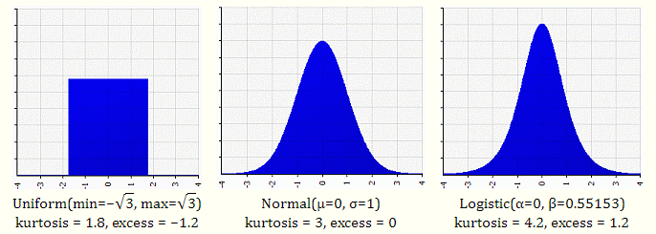
Kurtosis

Slide 13
DEMO
Analyze sales by month for global superstore
Simple exercise to understand skewness and kurtosis

Slide 14
Thank You!

